Slide 1

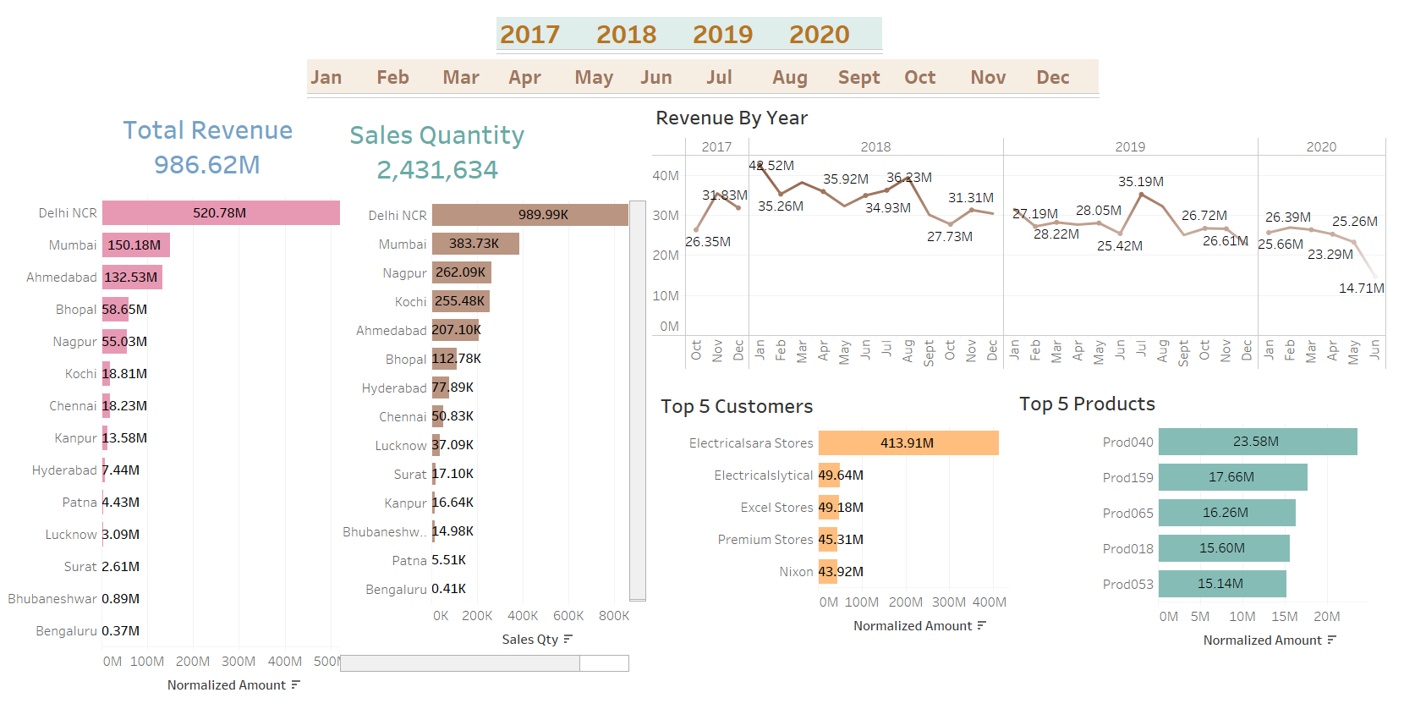
HARDWARE COMPANY SALES ANALYSIS

